Slide 1

Improvement(s) to the NPZD seasonal model
Anh H. Pham
Ecosystem Modeling

Slide 2
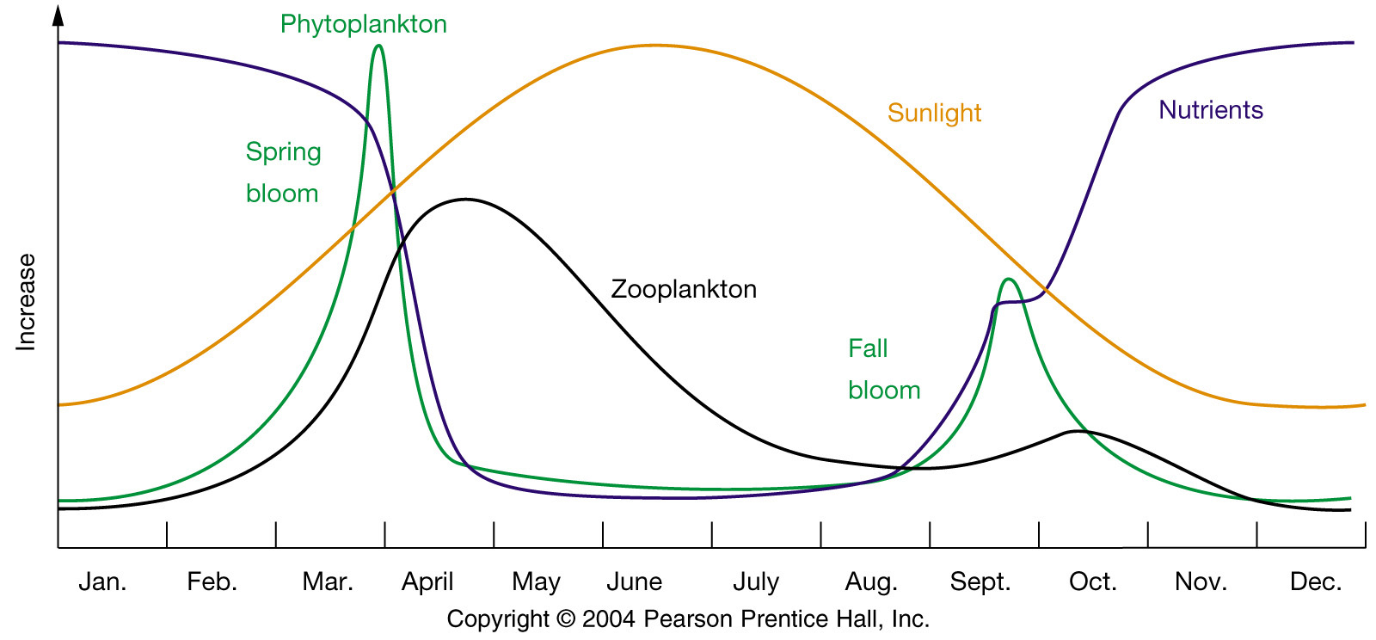
Phytoplankton seasonal cycle

Slide 3
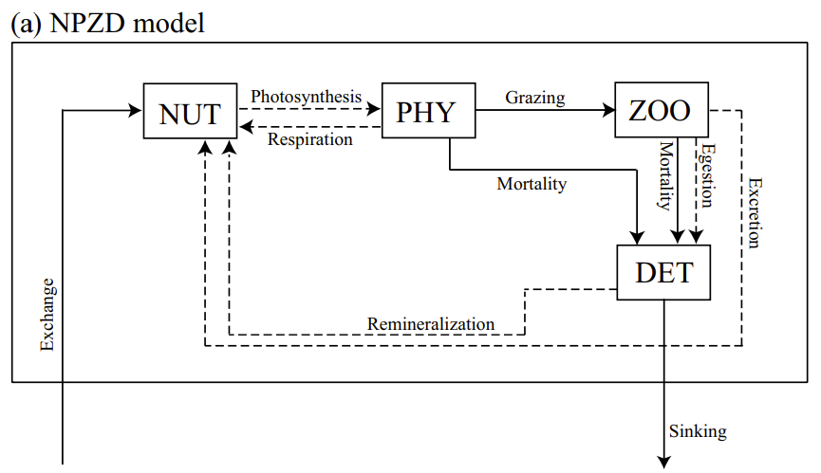
NPZD model
(Yoshikawa et al. 2005)

Slide 4
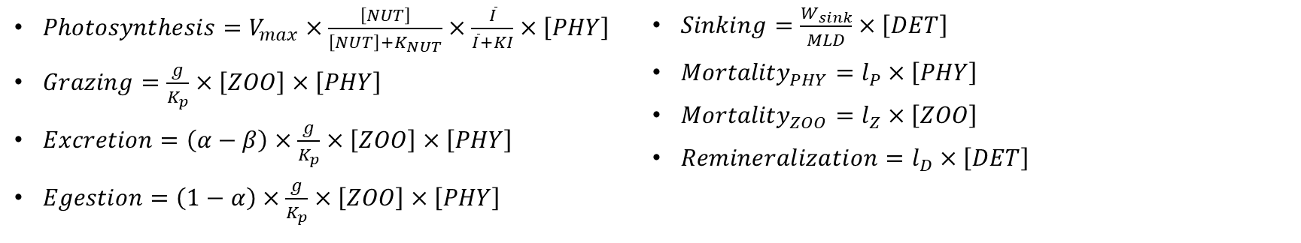
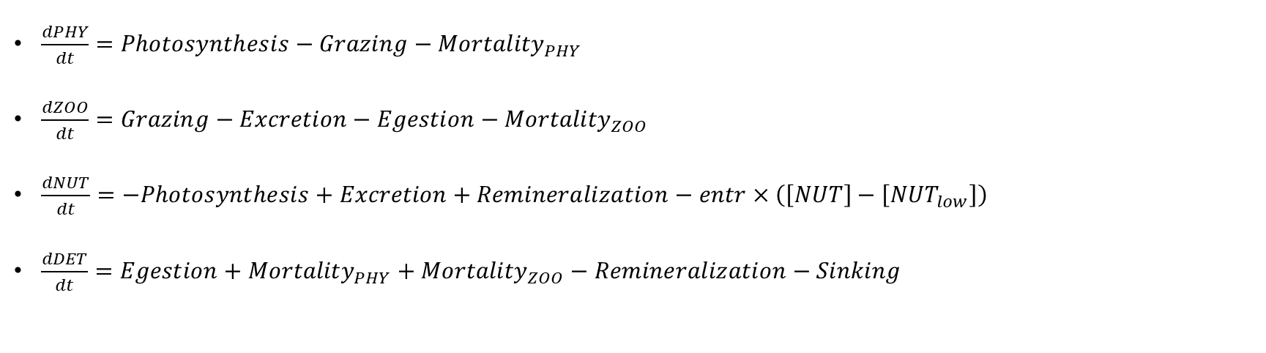
NPZD model
$\frac{dPHY}{dt}=Photosynthesis−Grazing−{Mortality}_{PHY}$
$\frac{dZOO}{dt}=Grazing−Excretion−Egestion−{Mortality}_{ZOO}$
$\frac{dNUT}{dt}=−Photosynthesis+Excretion+Remineralization−entr×\left(\left[NUT\right]−\left[{NUT}_{low}\right]\right)$
$\frac{dDET}{dt}=Egestion+{Mortality}_{PHY}+{Mortality}_{ZOO}−Remineralization−Sinking$
$Photosynthesis=V_{max}×\frac{\left[NUT\right]}{\left[NUT\right]+K_{NUT}}×\frac{\overline{I}}{\overline{I}+KI}×\left[PHY\right]$
$Grazing=\frac{g}{K_{p}}×\left[ZOO\right]×\left[PHY\right]$
$Excretion=\left(α−β\right)×\frac{g}{K_{p}}×\left[ZOO\right]×\left[PHY\right]$
$Egestion=\left(1−α\right)×\frac{g}{K_{p}}×\left[ZOO\right]×\left[PHY\right]$
$Sinking=\frac{W_{sink}}{MLD}×\left[DET\right]$
${Mortality}_{PHY}=l_{P}×\left[PHY\right]$
${Mortality}_{ZOO}=l_{Z}×\left[ZOO\right]$
$Remineralization=l_{D}×\left[DET\right]$
This is simple, what else can we do?

Slide 5
NPZD-isotope model – Why bother?
Stable isotopes are widely used to track source of chemicals
Biological processes discriminate against heavier isotopes → isotopic fractionation.
Different process has different fractionation magnitude.
Measuring the relative isotopic ratio gives insight to the underlying processes in the system.
¹⁵N
¹⁵N
¹⁴N
¹⁴N
¹⁴N
¹⁴N
¹⁵N
¹⁵N
¹⁴N
+
¹⁴N
¹⁴N
¹⁵N
Biological process
¹⁴N
¹⁴N
¹⁵N
¹⁵N
¹⁵N
¹⁵N
¹⁵N
¹⁴N
¹⁴N
¹⁵N
¹⁴N
¹⁴N
¹⁵N
¹⁴N
¹⁴N
Initial substrate
Product
Remaining Substrate

Slide 6
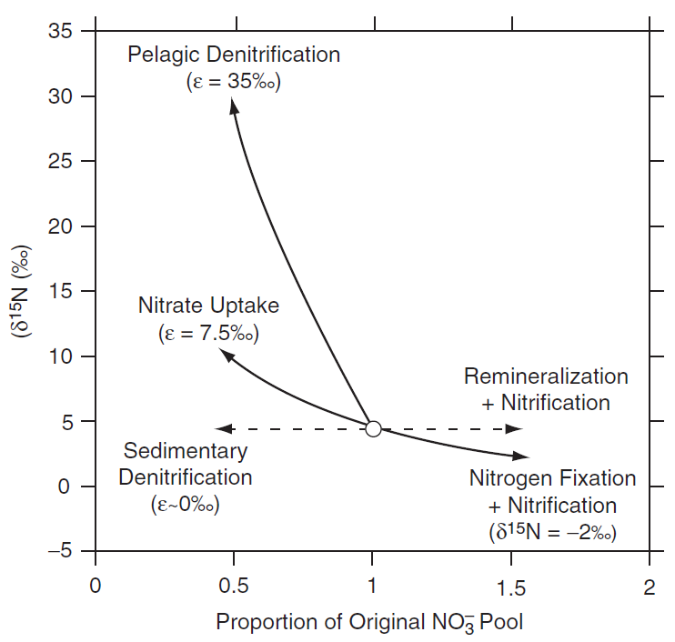
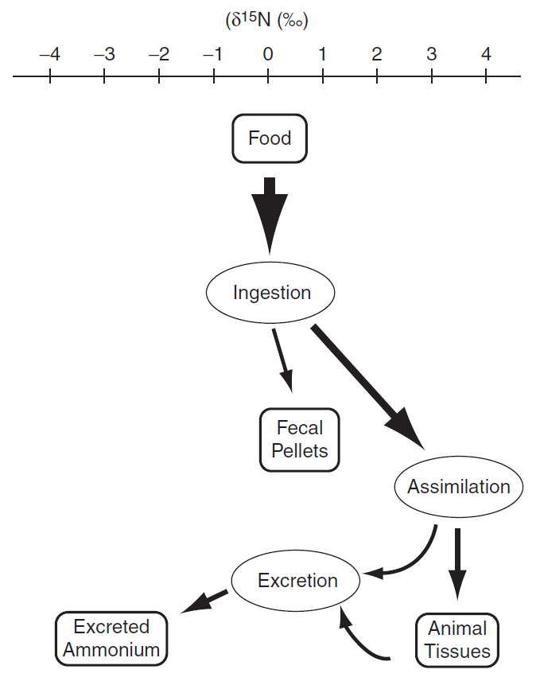
Isotope modeling
Easy for separate-closed-box model. How about mixed-open-box?
(Montoya 2008)
Notes:
e is called isotopic discrimination factor, change size for my model

Slide 7
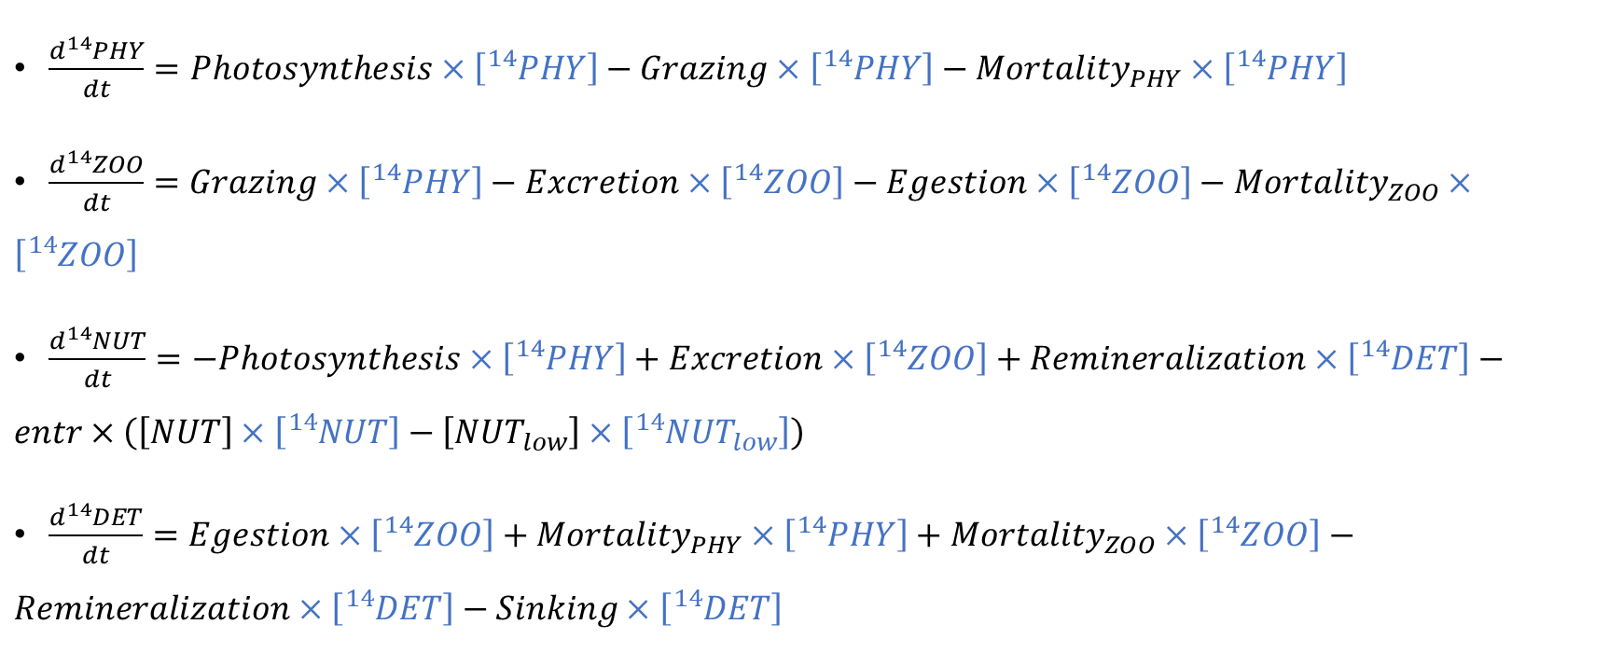
Isotope modeling – ¹⁴N
$\frac{d{}_{ }^{14}{PHY}}{dt}=Photosynthesis×\left[{}_{ }^{14}{PHY}\right]−Grazing×\left[{}_{ }^{14}{PHY}\right]−{Mortality}_{PHY}×\left[{}_{ }^{14}{PHY}\right]$
$\frac{d{}_{ }^{14}{ZOO}}{dt}=Grazing×\left[{}_{ }^{14}{PHY}\right]−Excretion×\left[{}_{ }^{14}{ZOO}\right]−Egestion×\left[{}_{ }^{14}{ZOO}\right]−{Mortality}_{ZOO}×\left[{}_{ }^{14}{ZOO}\right]$
$\frac{d{}_{ }^{14}{NUT}}{dt}=−Photosynthesis×\left[{}_{ }^{14}{PHY}\right]+Excretion×\left[{}_{ }^{14}{ZOO}\right]+Remineralization×\left[{}_{ }^{14}{DET}\right]−entr×\left(\left[NUT\right]×\left[{}_{ }^{14}{NUT}\right]−\left[{NUT}_{low}\right]×\left[{{}_{ }^{14}{NUT}}_{low}\right]\right)$
$\frac{d{}_{ }^{14}{DET}}{dt}=Egestion×\left[{}_{ }^{14}{ZOO}\right]+{Mortality}_{PHY}×\left[{}_{ }^{14}{PHY}\right]+{Mortality}_{ZOO}×\left[{}_{ }^{14}{ZOO}\right]−Remineralization×\left[{}_{ }^{14}{DET}\right]−Sinking×\left[{}_{ }^{14}{DET}\right]$

Slide 8
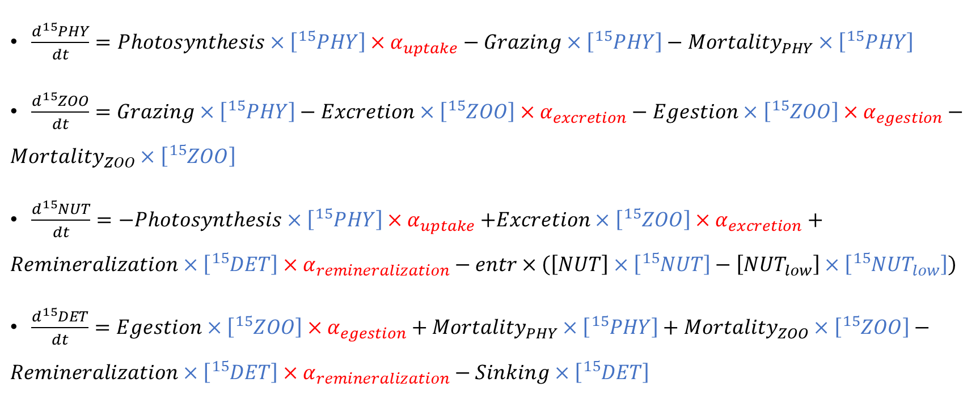
Isotope modeling – ¹⁵N
$\frac{d{}_{ }^{15}{PHY}}{dt}=Photosynthesis×\left[{}_{ }^{15}{PHY}\right]×α_{uptake}−Grazing×\left[{}_{ }^{15}{PHY}\right]−{Mortality}_{PHY}×\left[{}_{ }^{15}{PHY}\right]$
$\frac{d{}_{ }^{15}{ZOO}}{dt}=Grazing×\left[{}_{ }^{15}{PHY}\right]−Excretion×\left[{}_{ }^{15}{ZOO}\right]×α_{excretion}−Egestion×\left[{}_{ }^{15}{ZOO}\right]×α_{egestion}−{Mortality}_{ZOO}×\left[{}_{ }^{15}{ZOO}\right]$
$\frac{d{}_{ }^{15}{NUT}}{dt}=−Photosynthesis×\left[{}_{ }^{15}{PHY}\right]{×α}_{uptake}+Excretion×\left[{}_{ }^{15}{ZOO}\right]×α_{excretion}+Remineralization×\left[{}_{ }^{15}{DET}\right]×α_{remineralization}−entr×\left(\left[NUT\right]×\left[{}_{ }^{15}{NUT}\right]−\left[{NUT}_{low}\right]×\left[{{}_{ }^{15}{NUT}}_{low}\right]\right)$
$\frac{d{}_{ }^{15}{DET}}{dt}=Egestion×\left[{}_{ }^{15}{ZOO}\right]×α_{egestion}+{Mortality}_{PHY}×\left[{}_{ }^{15}{PHY}\right]+{Mortality}_{ZOO}×\left[{}_{ }^{15}{ZOO}\right]−Remineralization×\left[{}_{ }^{15}{DET}\right]×α_{remineralization}−Sinking×\left[{}_{ }^{15}{DET}\right]$

Slide 9

Isotope modeling – δ¹⁵N
Isotopic fractionation coefficient:
$$α=e^{\frac{ϵ}{1000}}$$
Isotope ratio:
$$R=\frac{{}_{ }^{15}N}{{}_{ }^{15}N+{}_{ }^{14}N}$$
Natural abundance of 15N in a sample relative to the isotopic composition of a standard reference material
$$δ{}_{ }^{15}N=\left(\frac{R_{sample}}{R_{standard}}−1\right)×1000$$
R_{standard} of atmospheric nitrogen is 0.00366

Slide 10
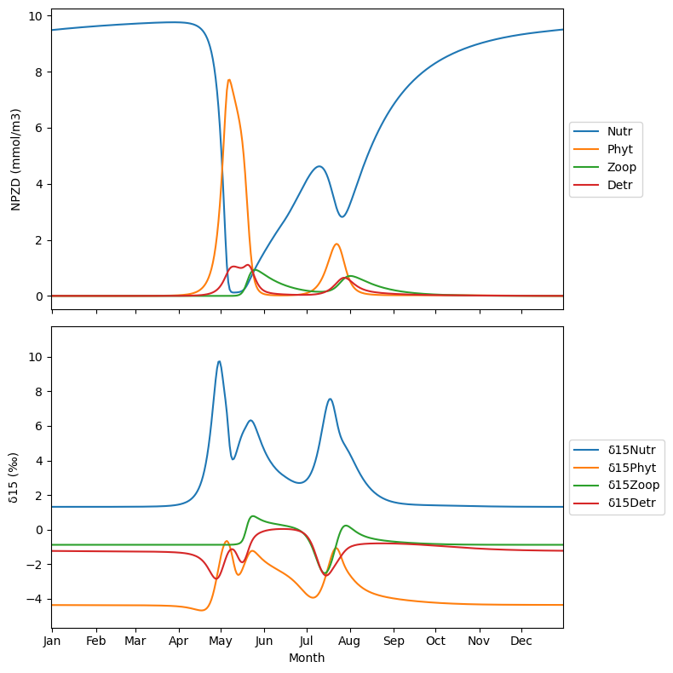
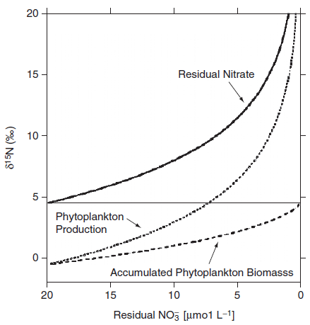
Isotope modeling
(Montoya 2008)
This is better, can we improve more?
Notes:
1st bloom: entrainment → nutrient uptake → mortality
Zooplankton growth: grazing → egestion, excretion → mortality
2nd bloom: remineralization

Slide 11
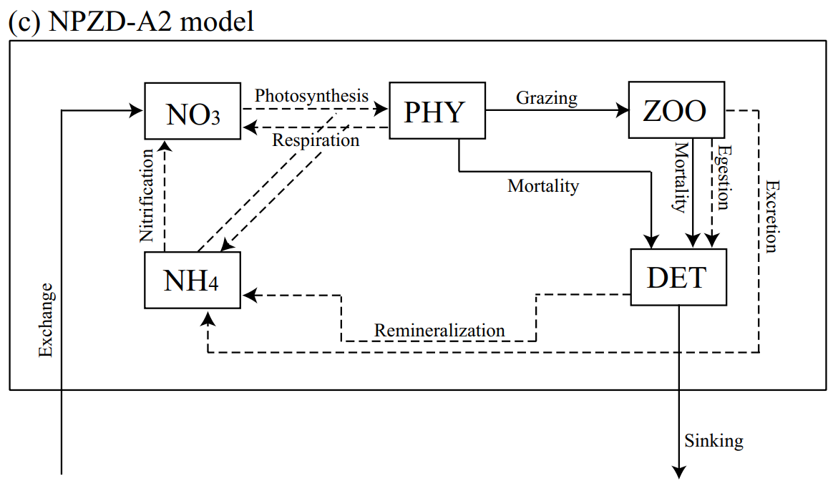
NPZD-A2 model
$$Photosynthesis=V_{max}×\left[\frac{\left[{NO}_{3}\right]}{\left[{NO}_{3}\right]+K_{{NO}_{3}}}×e^{−Ψ×\left[{NH}_{4}\right]}+\frac{\left[{NH}_{4}\right]}{\left[{NH}_{4}\right]+K_{{NH}_{4}}}\right]×\frac{\overline{I}}{\overline{I}+KI}×\left[PHY\right]$$
(Yoshikawa et al. 2005)

Slide 12
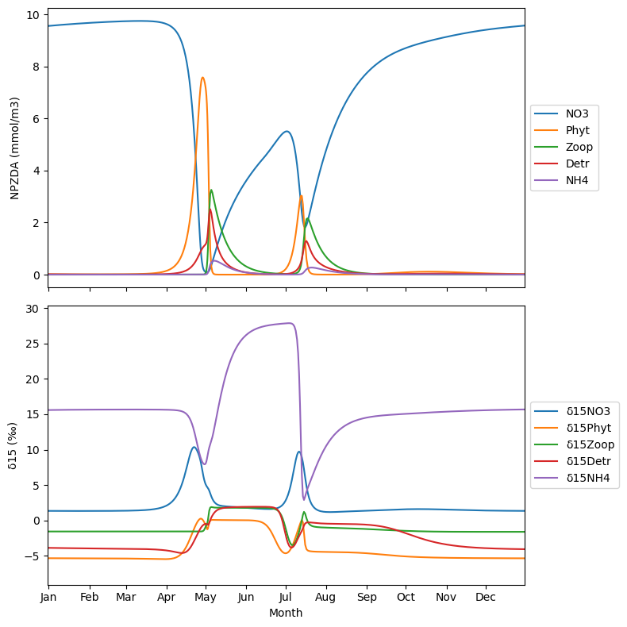
NPZD-A2 model
More realistic:
Light-driven spring bloom
Top-down controlled summer
Bottom-up controlled fall bloom
NH₄ immediately used up
How do we validate the model output?

Slide 13
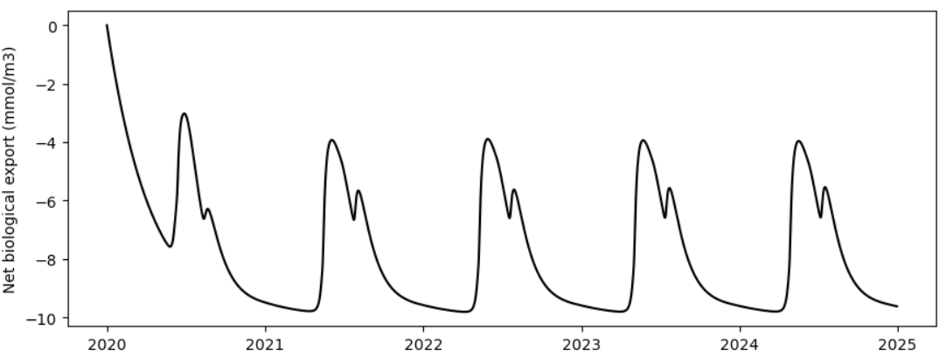
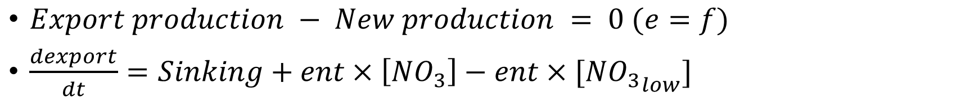
Model validation
$Export production − New production = 0 (e=f)$
$\frac{dexport}{dt}=Sinking+ent×\left[{NO}_{3}\right]−ent×[{{NO}_{3}}_{low}]$
What can we do with this model?

Slide 14
Takeaway
NPZD x isotope:
Validate Rayleigh distillation model
Nutrient uptake drive the isotopic signature in the upper ocean
Can be used to simulate in-situ δ15N measurements, seasonal variations
NPZD-A2 x isotope:
More realistic
NH₄ almost used up in the upper ocean
Cross-validate published values/measurements
Improvement:
Add Nitrogen fixation → isotopic signature balance
Add phytoplankton classes/bacterial loop → more complex questions

